Slide 1
OpenWorld 2018 ML 101: Oracle Data Miner UI + Oracle Autonomous Database Cloud’s Machine Learning Notebook BYOL [HOL5759]
Move the Algorithms; Not the Data!
Charlie Berger, MS Engineering, MBA Sr. Director Product Management, Machine Learning, AI and Cognitive Analytics charlie.berger@oracle.com, www.twitter.com/CharlieDataMine #OracleMachineLearning
Derrick Cameron, Oracle Solution Engineer, Developer Innovations, derrick.Cameron@oracle.com
Brendan Tierney, President, Oralytics, brendan.tierney@oralytics.com

Slide 3
ML 101: Oracle Data Miner/ Oracle Autonomous Data Warehouse Cloud Machine Learning Notebook BYOL [HOL5759]
PLEASE NOTE: YOU MUST BRING YOUR OWN LAPTOP (BYOL) TO PARTICIPATE IN THE HANDS-ON LABS. In this hands-on lab, learn the fast and easy way to do machine learning with Oracle SQL Developer 18.2’s Oracle Data Miner drag-and-drop workflow UI. Learn from several experts who will provide one-on-one coaching, guidance, and instruction as requested in various hands-on tutorials. Ask questions, get answers, and come away with a comfort level for using Oracle’s machine learning capabilities in your use cases. Also try the new Oracle Machine Learning Zeppelin-based notebook for Oracle Autonomous Data Warehouse Cloud. Oracle Machine Learning extends Oracle’s offerings for data science in the cloud, and its collaborative notebook environment helps data scientists build, share, document, and automate data analysis methodologies that run in Oracle Autonomous Data Warehouse Cloud.
Code One Tracks: Database, Big Data, and Data Science
Session Type: HOL (Hands-on Lab) Session
SPEAKERS
Brendan Tierney, President, Oralytics
Charlie Berger, Sr. Director Product Management, Machine Learning, AI and Cognitive Analytics, Oracle
Derrick Cameron, Oracle Solution Engineer, Developer Innovations, Oracle
Monday, Oct 22, 2:45 p.m. - 4:45 p.m. | Moscone West - Overlook 2A (HOL)

Slide 4
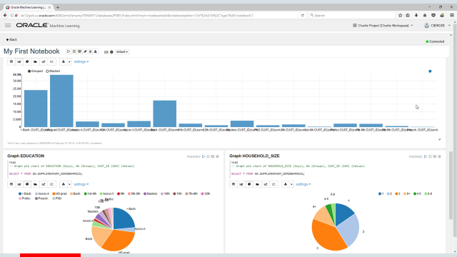

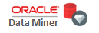
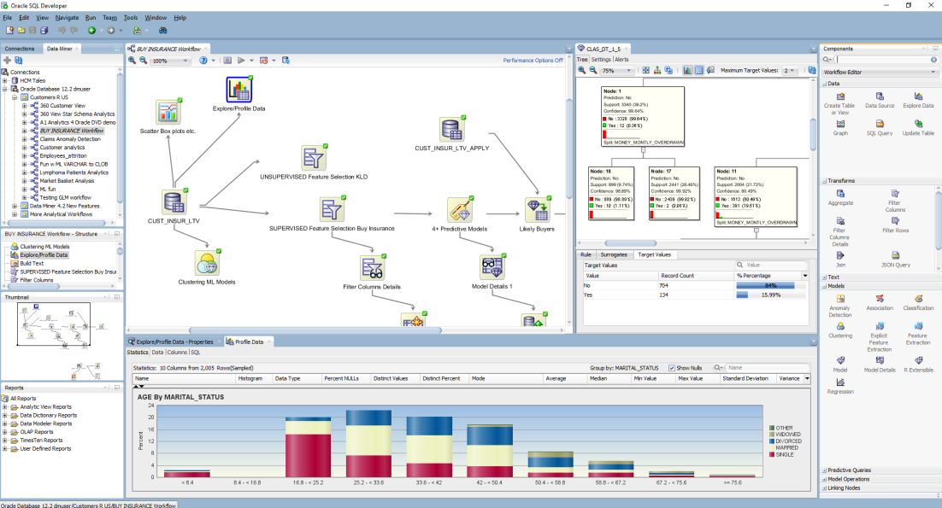
ML 101: Oracle Data Miner/ Oracle Autonomous Data Warehouse Cloud Machine Learning Notebook
Oracle Machine Learning (ADWC)
Overview & Machine Learning Concepts
Oracle Machine Learning notebooks
Do as many OML Example notebooks as you can in the 2 hours HOL
Do the Credit Scoring Workshop
Ask questions! We’re all here to assist and discuss your use cases!
Oracle Data Miner (SQLDEV + DB)
Quick Oracle Data Miner GUI Demo
Environment
Oracle 18c on the Oracle Database Cloud
Will be using SQL Developer 18.2
Try to do 3-5 Oracle Data Miner Tutorials
Instructors will walk around helping

Slide 5
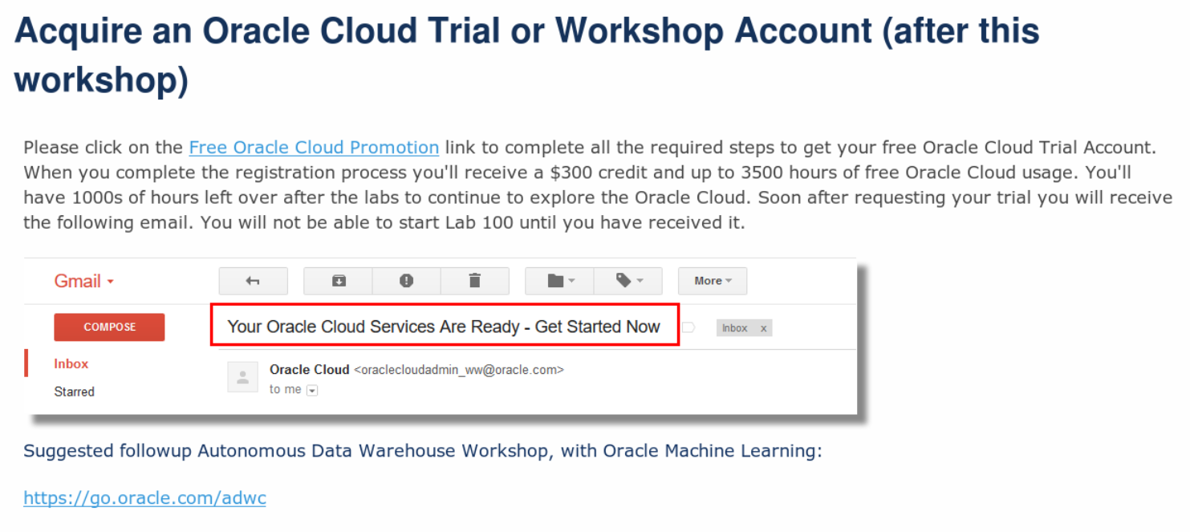
For Follow Up After this HOL...

Slide 6
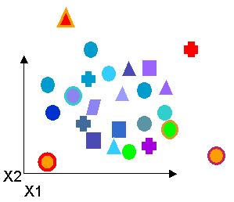
ML 101: Machine Learning, Data Mining, Predictive Analytics
Automatically sift through large amounts of data to find hidden patterns, discover new insights and make predictions
A1 A2 A3 A4 A5 A6 A7
Identify most important factor (Attribute Importance)
Predict customer behavior (Classification)
Predict or estimate a value (Regression)
Find profiles of targeted people or items (Decision Trees)
Segment a population (Clustering)
Find fraudulent or “rare events” (Anomaly Detection)
Determine co-occurring items in a “baskets” (Associations)

Slide 7
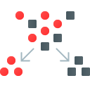



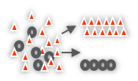

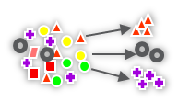

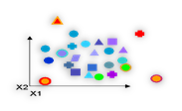
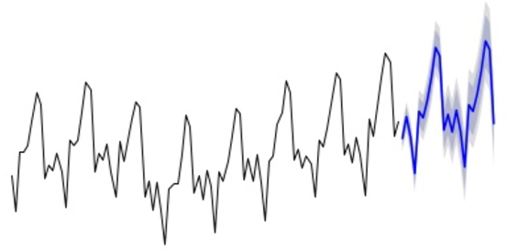

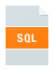
Oracle’s Machine Learning Algorithms
Classification
Naïve Bayes
Logistic Regression (GLM)
Decision Tree
Random Forest
Neural Network
Support Vector Machine
Explicit Semantic Analysis
Clustering
Hierarchical K-Means
Hierarchical O-Cluster
Expectation Maximization (EM)
Anomaly Detection
One-Class SVM
Time Series
State of the art forecasting using Exponential Smoothing.
Includes all popular models e.g. Holt-Winters with trends, seasons, irregularity, missing data
Regression
Linear Model
Generalized Linear Model
Support Vector Machine (SVM)
Stepwise Linear regression
Neural Network
LASSO
Attribute Importance
Minimum Description Length
Principal Comp Analysis (PCA)
Unsupervised Pair-wise KL Div
CUR decomposition for row & AI
Association Rules
A priori/ market basket
Predictive Queries
Predict, cluster, detect, features
SQL Analytics
SQL Windows, SQL Patterns, SQL Aggregates
Feature Extraction
Principal Comp Analysis (PCA)
Non-negative Matrix Factorization
Singular Value Decomposition (SVD)
Explicit Semantic Analysis (ESA)
Text Mining Support
Algorithms support text type
Tokenization and theme extraction
Explicit Semantic Analysis (ESA) for document similarity
Statistical Functions
Basic statistics: min, max, median, stdev, t-test, F-test, Pearson’s, Chi-Sq, ANOVA, etc.
R Packages
CRAN R Algorithm Packages through Embedded R Execution
Spark MLlib algorithm integration
Exportable ML Models
REST APIs for deployment
A1 A2 A3 A4 A5 A6 A7
OAA (Oracle Data Mining + Oracle R Enterprise) and ORAAH combined
OAA includes support for Partitioned Models, Transactional, Unstructured, Geo-spatial, Graph data. etc,
Notes:
This setting specifies the model.
EXSM_SIMPLE: Simple exponential
smoothing model is applied.
EXSM_SIMPLE_MULT: Simple exponential
smoothing model with multiplicative error is
applied.
EXSM_HOLT: Holt linear exponential
smoothing model is applied.
EXSM_HOLT_DMP: Holt linear exponential
smoothing model with damped trend is
applied.
EXSM_MUL_TRND: Exponential smoothing
model with multiplicative trend is applied.
EXSM_MULTRD_DMP: Exponential smoothing
model with multiplicative damped trend is
applied.
EXSM_SEAS_ADD: Exponential smoothing with
additive seasonality, but no trend, is
applied.
EXSM_SEAS_MUL: Exponential smoothing with
multiplicative seasonality, but no trend, is
applied.
EXSM_HW: Holt-Winters triple exponential
smoothing model, additive trend,
multiplicative seasonality is applied.
EXSM_HW_DMP: Holt-Winters multiplicative
exponential smoothing model with damped
trend, additive trend, multiplicative
seasonality is applied.
EXSM_HW_ADDSEA: Holt-Winters additive
exponential smoothing model, additive
trend, additive seasonality is applied.
EXSM_DHW_ADDSEA: Holt-Winters additive
exponential smoothing model with damped
trend, additive trend, additive seasonality is
applied.
EXSM_HWMT: Holt-Winters multiplicative
exponential smoothing model with
multiplicative trend, multiplicative trend,
multiplicative seasonality is applied.
EXSM_HWMT_DMP: Holt-Winters multiplicative
exponential smoothing model with damped
multiplicative trend, multiplicative trend,
multiplicative seasonality is applied.
The default value is EXSM_SIMPLE.

Slide 8

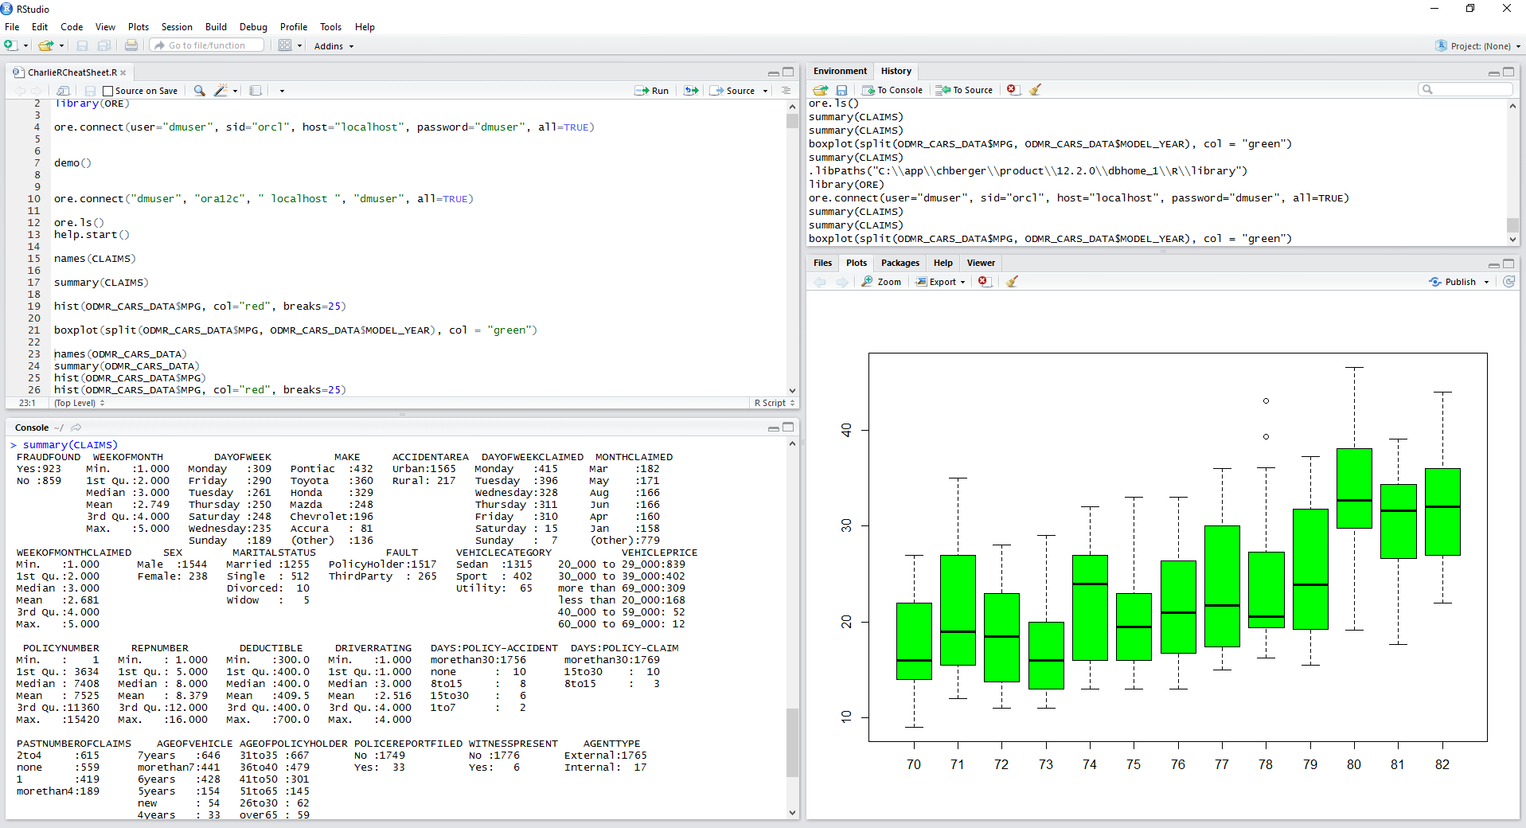
Oracle’s Machine Learning & Advanced Analytics
Fastest Way to Deliver Scalable Enterprise-wide Predictive Analytics
Key Features
Parallel, scalable machine learning algorithms and R integration
In-Database processing + Spark/Hadoop —Don’t move the data
Data analysts, data scientists & developers
Drag and drop workflow, R and SQL APIs
Extends data management into powerful advanced/predictive analytics platform
Enables enterprise predictive analytics deployment + applicationsX
Notes:
Oracle Advanced Analytics is the fastest way to deliver scalable enterprise-wide predictive analytics. OAA provides a wide range of powerful, workhorse data mining algorithms and integration with open source R algorithms. OAA’s analytical functions can be accessed by SQL, PL/SQL and R.
All OAA analytical functions provide in-database execution and take advantage of all the database’s parallel, scalable technology including Exadata “smart scan” technology.
Data analysts can use the Oracle Data Miner GUI, an extension to SQL Developer to develop and share analytical workflows and when they are done, Oracle Data Miner automatically generates the associated SQL scripts that can be used to accelerate deployment.
R users can write R scripts that are automatically converted via OAA’s R to SQL transparency layer.
By enabling data analysts to analyze data inside the database, OAA enables enterprise analytical applications—as we’ll see in a few more slides.

Slide 9

Oracle’s Machine Learning & Advanced Analytics
Fastest Way to Deliver Enterprise-wide Predictive Analytics
Traditional ML
Oracle’s in-DB Machine Learning
Major Benefits
Data Import
Data Mining
Data remains in Database & Hadoop
Model building and scoring occur in-database
Use R packages with data-parallel invocations
Leverage investment in Oracle IT
Eliminate data duplication
Eliminate separate analytical servers
Deliver enterprise-wide applications
GUI for ML/Predictive Analytics & code gen
R interface leverages database as HPC engine
Model “Scoring”
Data Prep. &
Transformation
avings
Data Mining
Model Building
Data Prep &
Transformation
Data Extraction
Model “Scoring”
Embedded Data Prep
Model Building
Data Preparation
Hours, Days or Weeks
Secs, Mins or Hours

Slide 10

Model Build & Real-time SQL Apply Prediction
Simple SQL Syntax
ML Model Build (PL/SQL)
begin
dbms_data_mining.create_model('BUY_INSUR1', 'CLASSIFICATION',
'CUST_INSUR_LTV', 'CUST_ID', 'BUY_INSURANCE', CUST_INSUR_LTV_SET');
end;
/
Model Apply (SQL query)
Select prediction_probability(BUY_INSUR1, 'Yes'
USING 3500 as bank_funds, 825 as checking_amount, 400 as credit_balance, 22 as age, 'Married' as marital_status, 93 as MONEY_MONTLY_OVERDRAWN, 1 as house_ownership)
from dual;
Notes:
drop table CUST_INSUR_LTV_SET;
exec dbms_data_mining.drop_model('BUY_INSUR1');
create table CUST_INSUR_LTV_SET (setting_name varchar2(30), setting_value varchar2(4000));
insert into CUST_INSUR_LTV_SET values ('ALGO_NAME','ALGO_SUPPORT_VECTOR_MACHINES');
insert into CUST_INSUR_LTV_SET values ('PREP_AUTO','ON');
commit;
begin
dbms_data_mining.create_model('BUY_INSUR1', 'CLASSIFICATION',
'CUST_INSUR_LTV', 'CUST_ID', 'BUY_INSURANCE', 'CUST_INSUR_LTV_SET');
end;
/
Select prediction_probability(BUY_INSUR1, 'Yes'
USING 3500 as bank_funds, 825 as checking_amount, 400 as credit_balance, 22 as age, 'Married' as marital_status, 93 as MONEY_MONTLY_OVERDRAWN, 1 as house_ownership)
from dual;

Slide 11
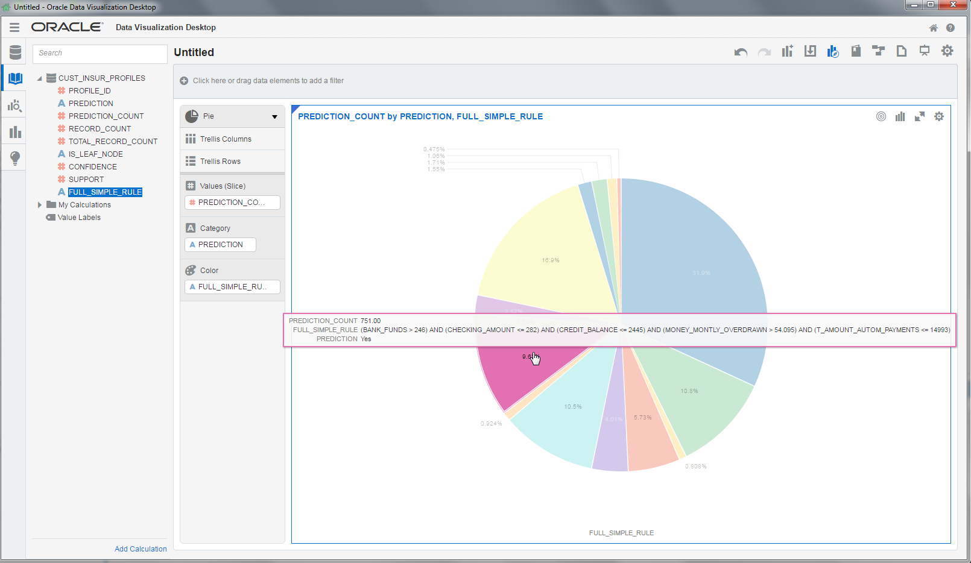

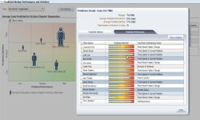


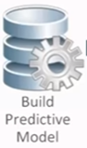
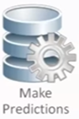
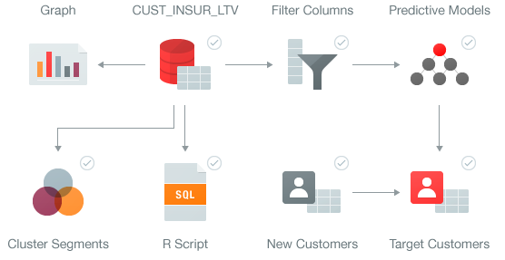






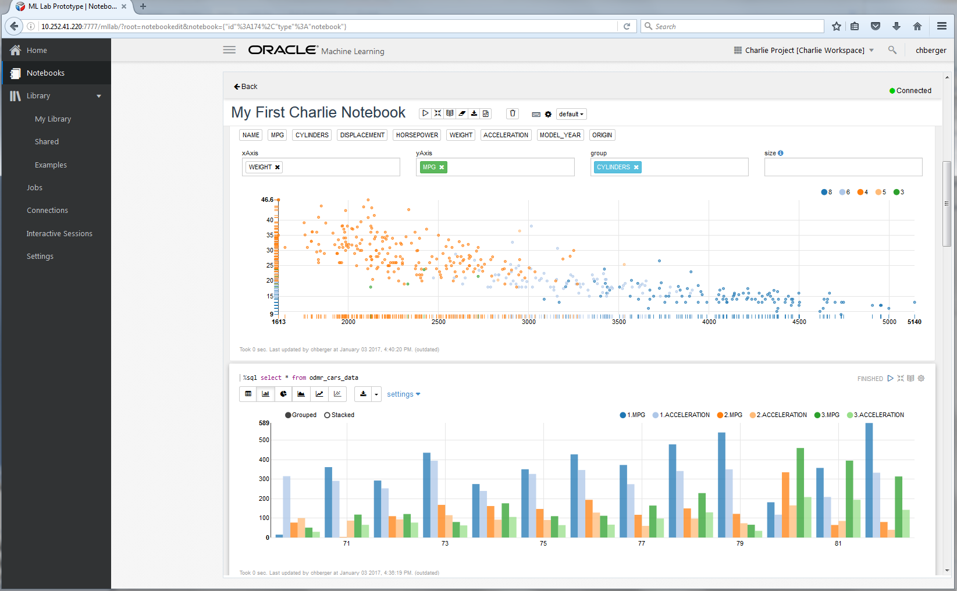
Multiple Data Scientist User Roles Supported
Oracle’s Machine Learning/Advanced Analytics
Additional relevant data and “engineered features”
Historical or Current Data to be “scored” for predictions
Oracle Database 12c
Historical data
Assembled historical data
Predictions & Insights
Sensor data, Text, unstructured data, transactional data, spatial data, etc.
DBAs
Application Developers
New!
R, Python Users, Data Scientists
OML Notebook Users
Data Analysts, Citizen Data Scientists

Slide 12
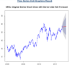
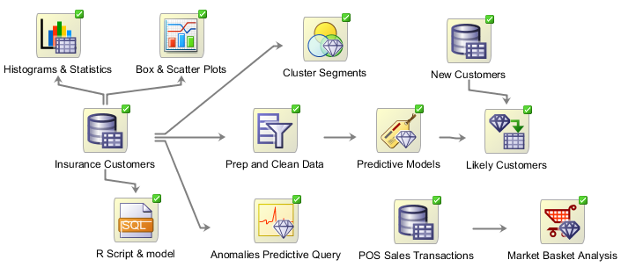
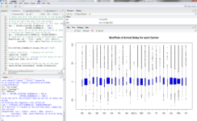
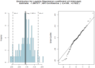
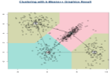
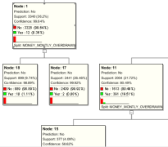
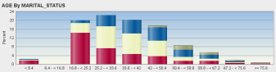
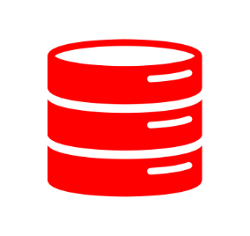

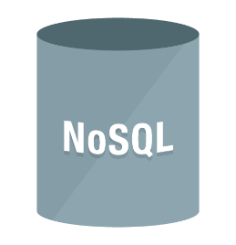



Manage and Analyze All Your Data
Data Scientists, R Users, Citizen Data Scientists
Architecturally, Many Options and Flexibility
SQL / R
Boil down the Data Lake
Big Data SQL / R
“Engineered Features” – Derived attributes that reflect domain knowledge—key to best models e.g.:
Counts
Totals
Changes over time
Object Store

Slide 13
Oracle Autonomous Data Warehouse Cloud & Oracle Machine Learning SQL Notebook

Slide 14
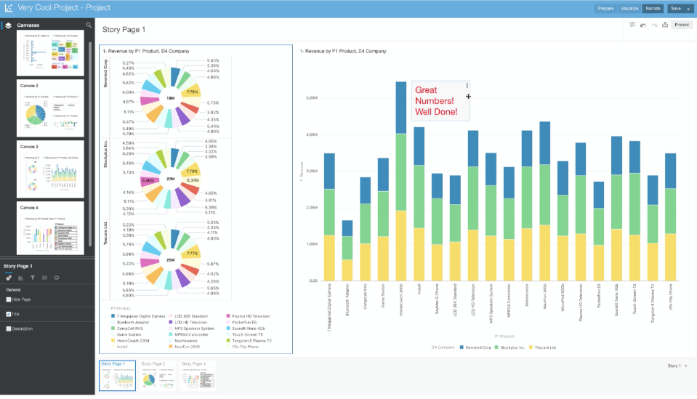
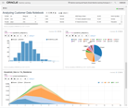
ADWC + Oracle Machine Learning Notebooks
Developer
Tools
Autonomous Data Warehouse Cloud
Analytics
Data Warehouse Services
(EDWs, DW, departmental marts and sandboxes)
Service Management
Built-in Access Tools
Oracle Business Analytics Cloud
Oracle Exadata Cloud Service
Oracle Database Cloud Service
Express Cloud Service
Oracle SQL Developer
Oracle Analytics Cloud
Service Console
Oracle Machine Learning
3rd Party Analytics on
Oracle Cloud Compute
Data Integration
Services
Oracle Data Integration Platform Cloud
3rd Party Analytics
On-premises
Autonomous Database Cloud
3rd Party DI on
Oracle Cloud Compute
Oracle Object Storage Cloud
Flat Files and Staging
3rd Party DI
On-premises
Notes:
The Autonomous Data Warehouse Cloud is the core component and other elements will plug into it.
Some of these will plug in as we move forward, some of these will plug-in from day one.
Oracle Autonomous Data Warehouse Cloud supports:
1. Existing tools running on-premise or in Oracle Cloud
Oracle BI and data-integration tools
3rd party BI tools
3rd party data-integration tools
Connectivity via SQL*Net
2. Oracle Cloud Services
Oracle Analytics Cloud
Oracle Data Integration Platform Cloud
and others…

Slide 15

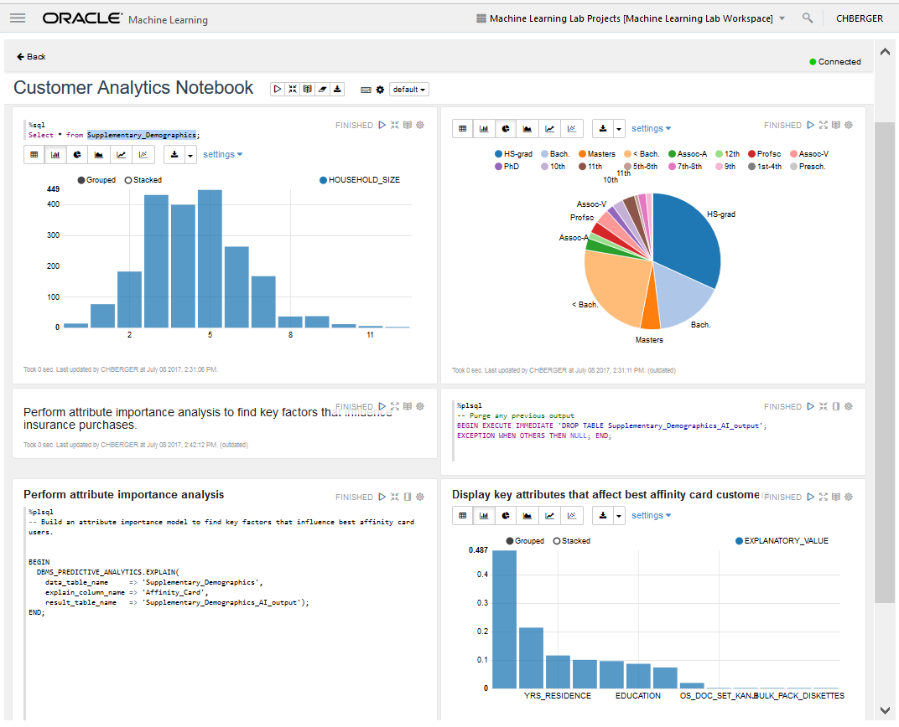
ML 101: Oracle Machine Learning
Machine Learning Notebook for Autonomous Data Warehouse Cloud
Key Features
Collaborative UI for data scientists
Packaged with Autonomous Data Warehouse Cloud (V1)
Easy access to shared notebooks, templates, permissions, scheduler, etc.
SQL ML algorithms API (V1)
Supports deployment of ML analytics

Slide 16
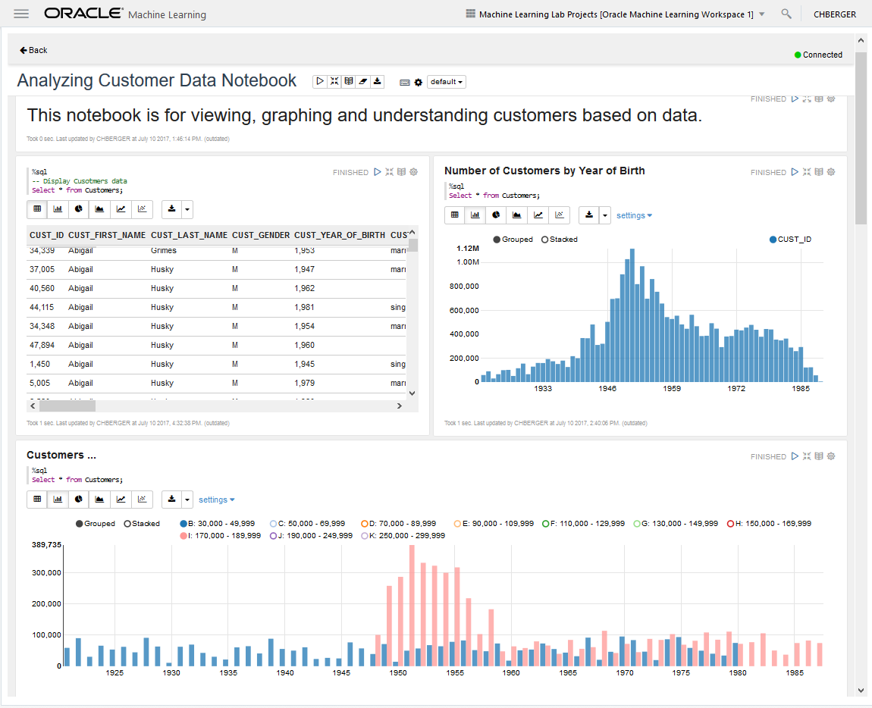
ML 101: Oracle Machine Learning
Machine Learning Notebook for Autonomous Data Warehouse Cloud
Key Features
Collaborative UI for data scientists
Packaged with Autonomous Data Warehouse Cloud (V1)
Easy access to shared notebooks, templates, permissions, scheduler, etc.
SQL ML algorithms API (V1)
Supports deployment of ML analytics

Slide 17
Oracle’s Machine Learning & Adv. Analytics Algorithms
Classification
Naïve Bayes
Logistic Regression (GLM)
Decision Tree
Random Forest
Neural Network
Support Vector Machine
Explicit Semantic Analysis
Clustering
Hierarchical K-Means
Hierarchical O-Cluster
Expectation Maximization (EM)
Anomaly Detection
One-Class SVM
Time Series
Holt-Winters, Regular & Irregular, with and w/o trends & seasonal
Single, Double Exp Smoothing
Regression
Linear Model
Generalized Linear Model
Support Vector Machine (SVM)
Stepwise Linear regression
Neural Network
Attribute Importance
Minimum Description Length
Principal Comp Analysis (PCA)
Unsupervised Pair-wise KL Div
Association Rules
A priori/ market basket
Predictive Queries
Predict, cluster, detect, features
SQL Analytics
SQL Windows, SQL Patterns, SQL Aggregates
Feature Extraction
Principal Comp Analysis (PCA)
Non-negative Matrix Factorization
Singular Value Decomposition (SVD)
Explicit Semantic Analysis (ESA)
Statistical Functions
Basic statistics: min, max, median, stdev, t-test, F-test, Pearson’s, Chi-Sq, ANOVA, etc.
A1 A2 A3 A4 A5 A6 A7
OAA includes support for Partitioned Models, Transactional, data. etc,

Slide 18
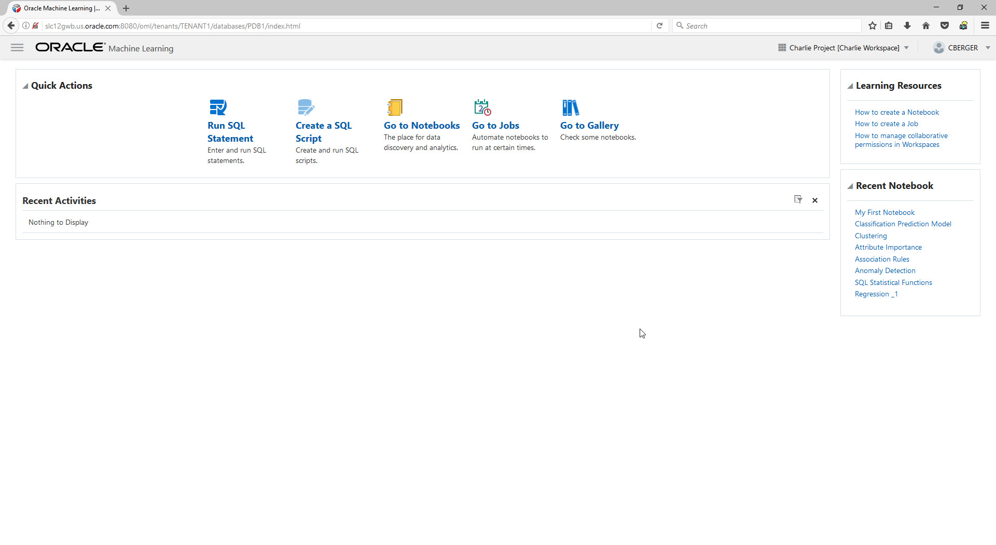
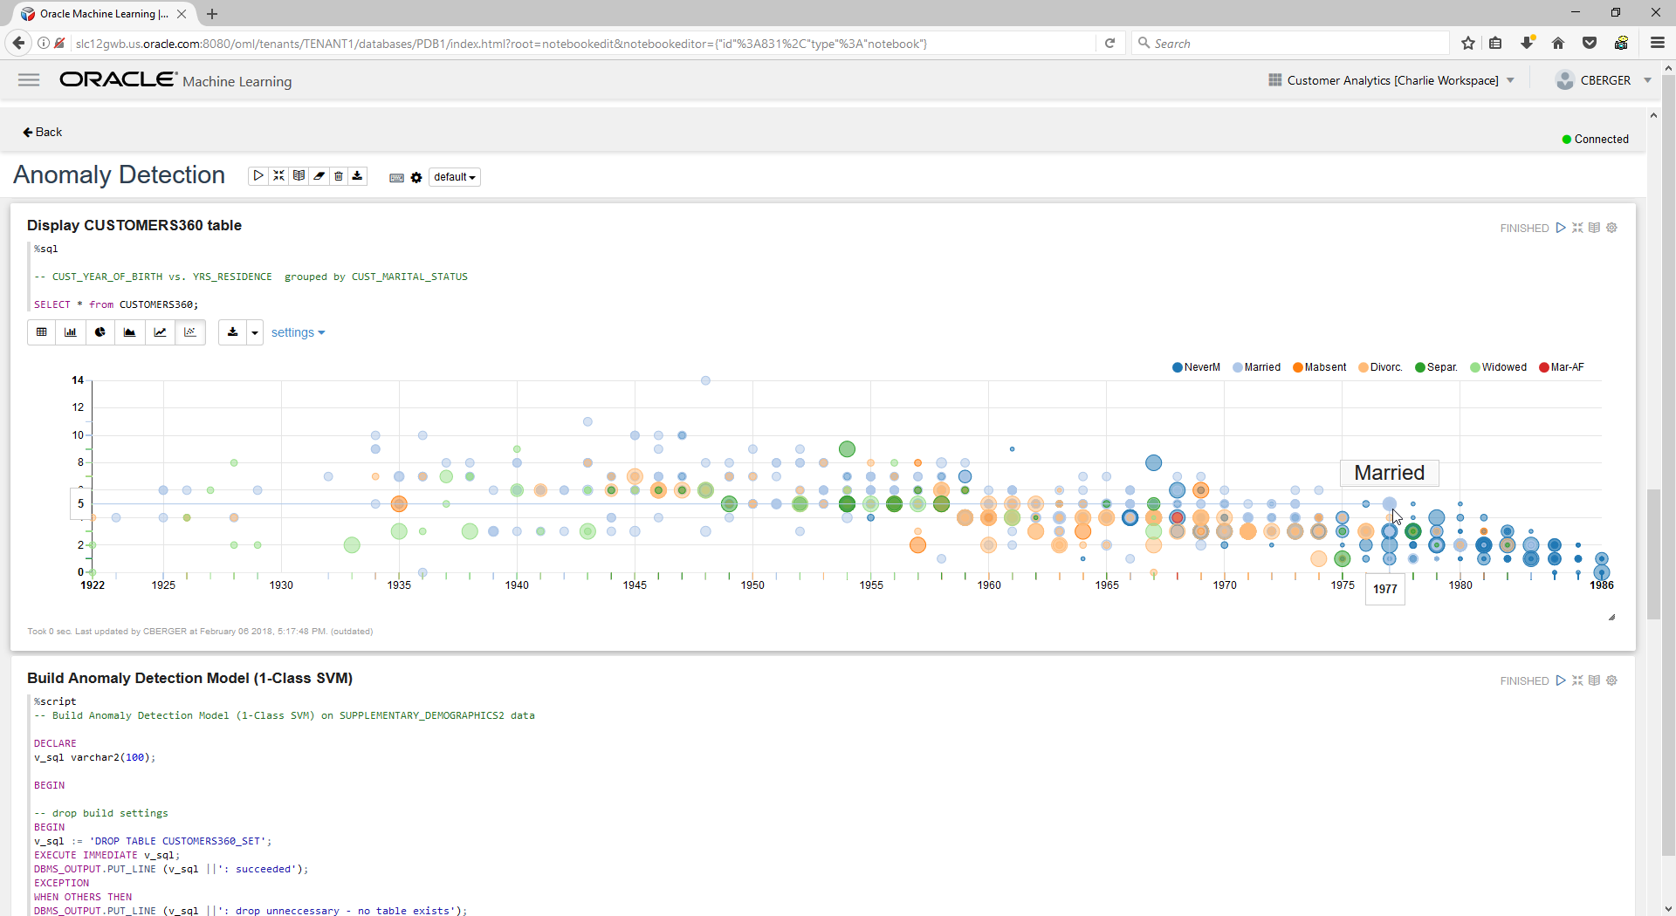
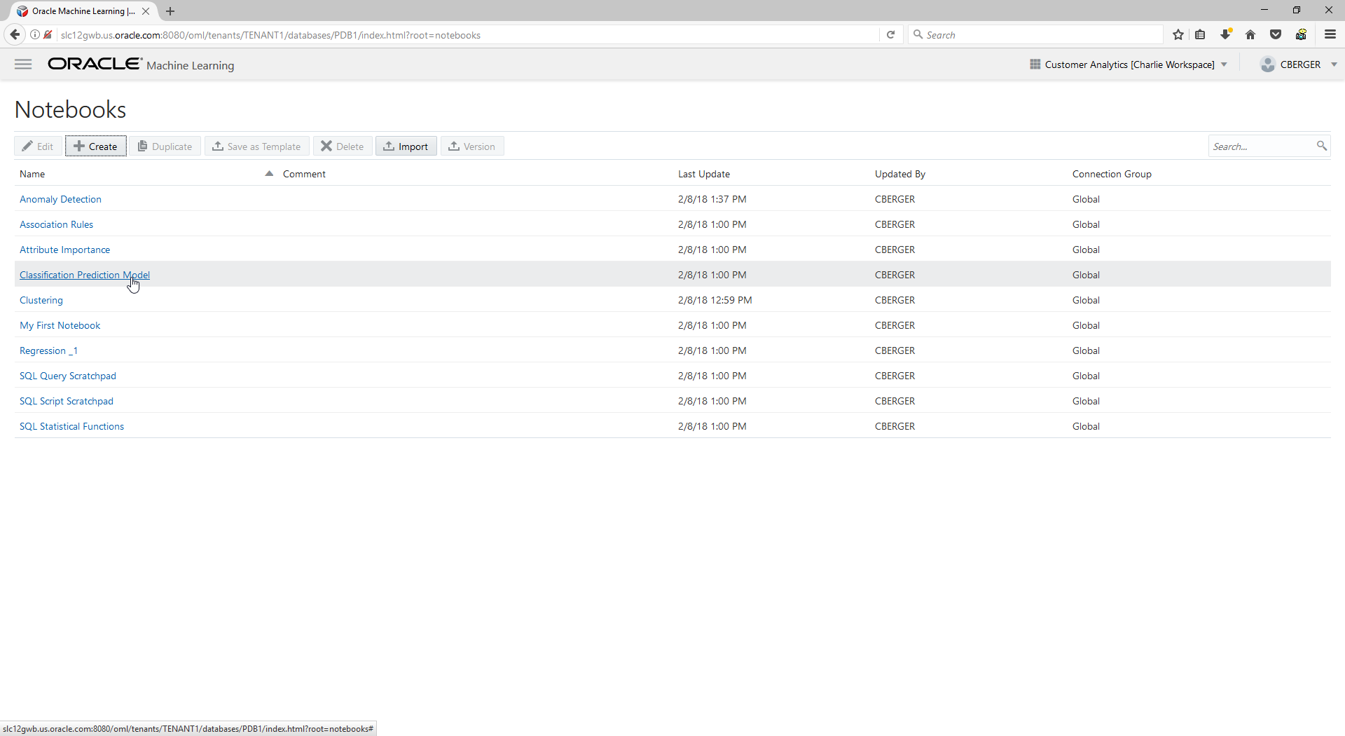
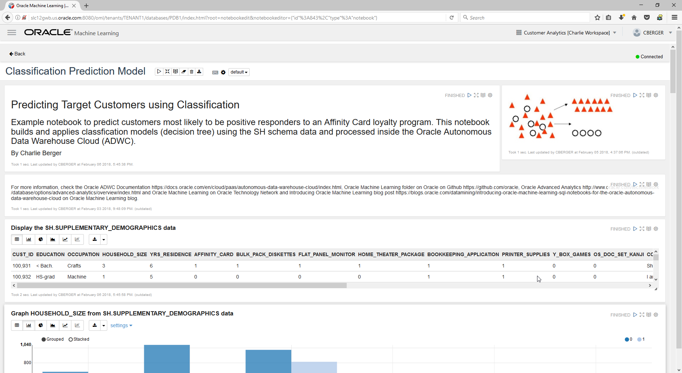
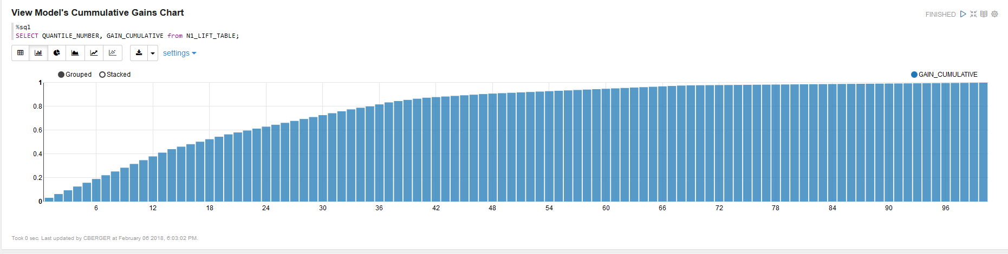
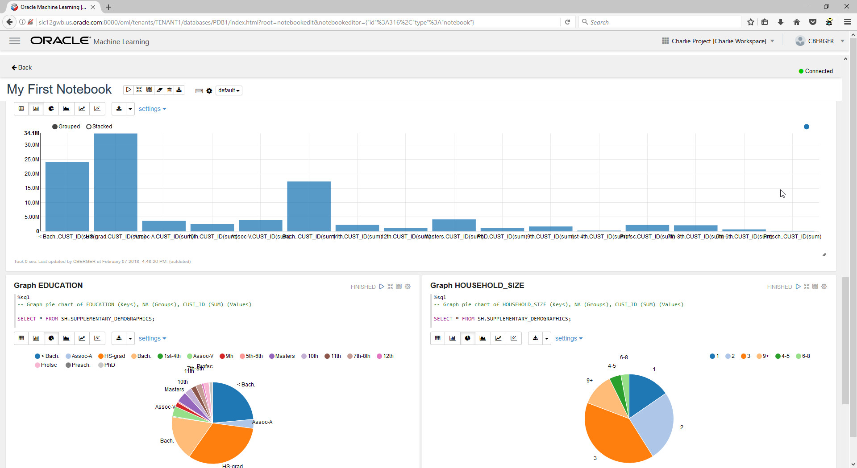
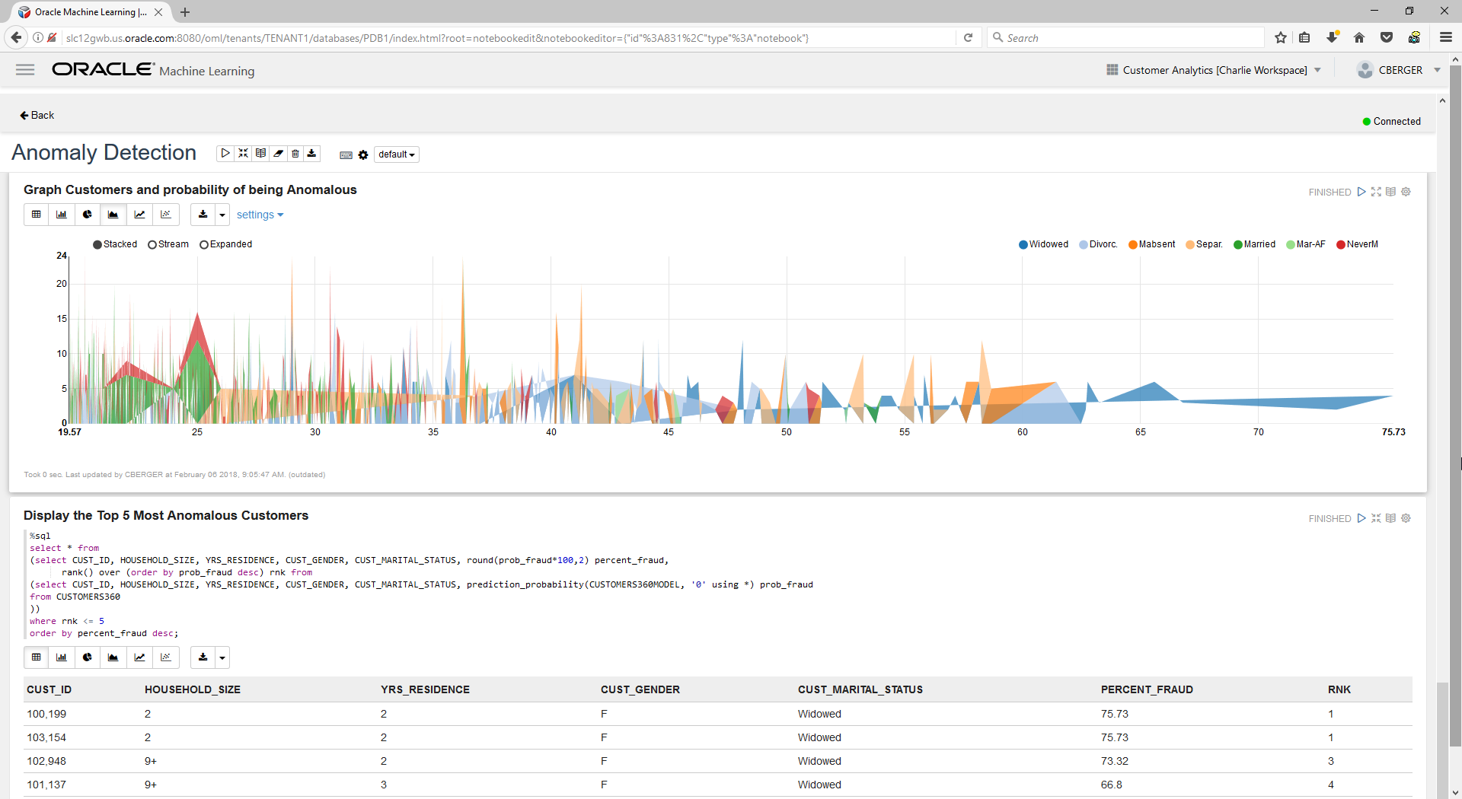
Oracle Machine Learning Quick DEMO

Slide 19
ML 101: ADWC + Oracle Machine Learning HOL Environment and Setup https://dgcameron.github.io/adwcml_oow/?page=README.md
1
Go to this URL to start the Workshop and both labs

Slide 20
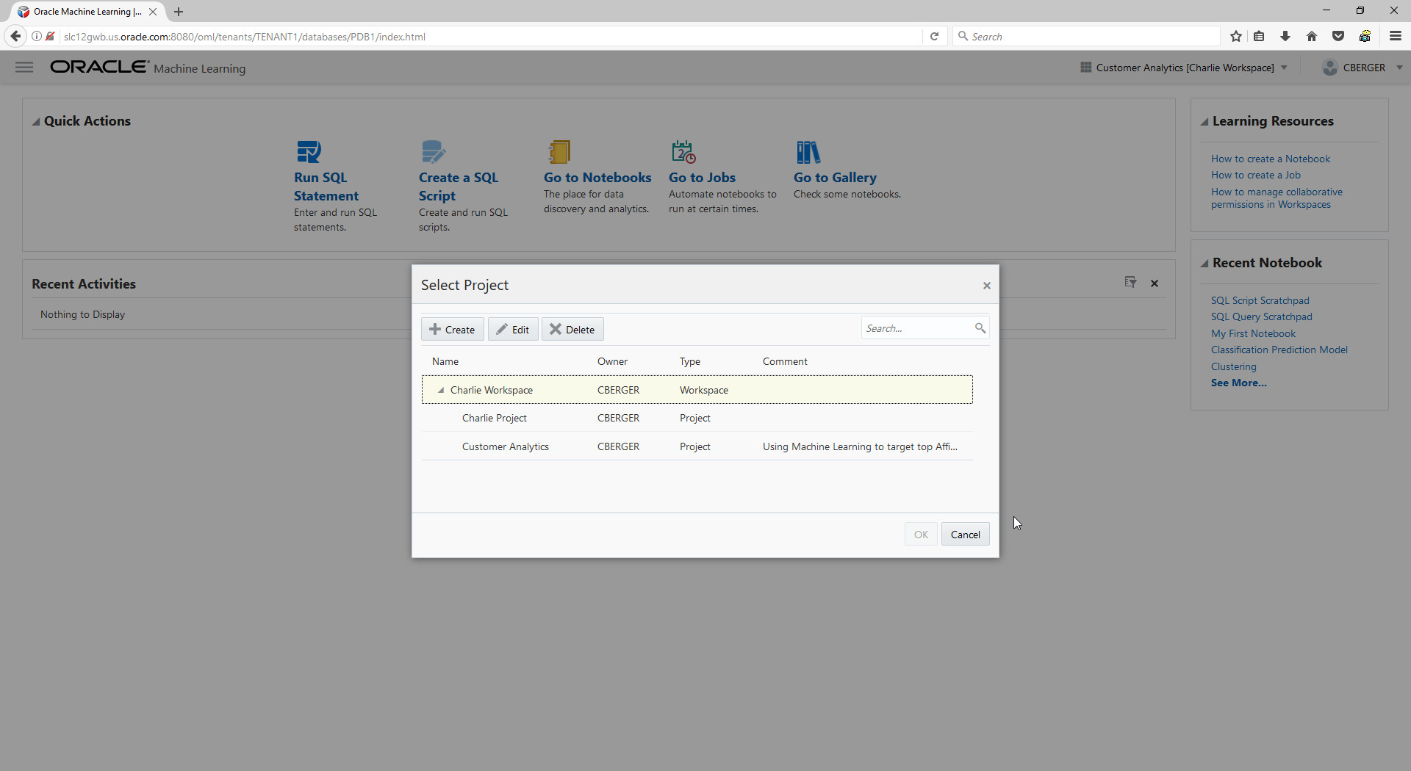

Slide 22
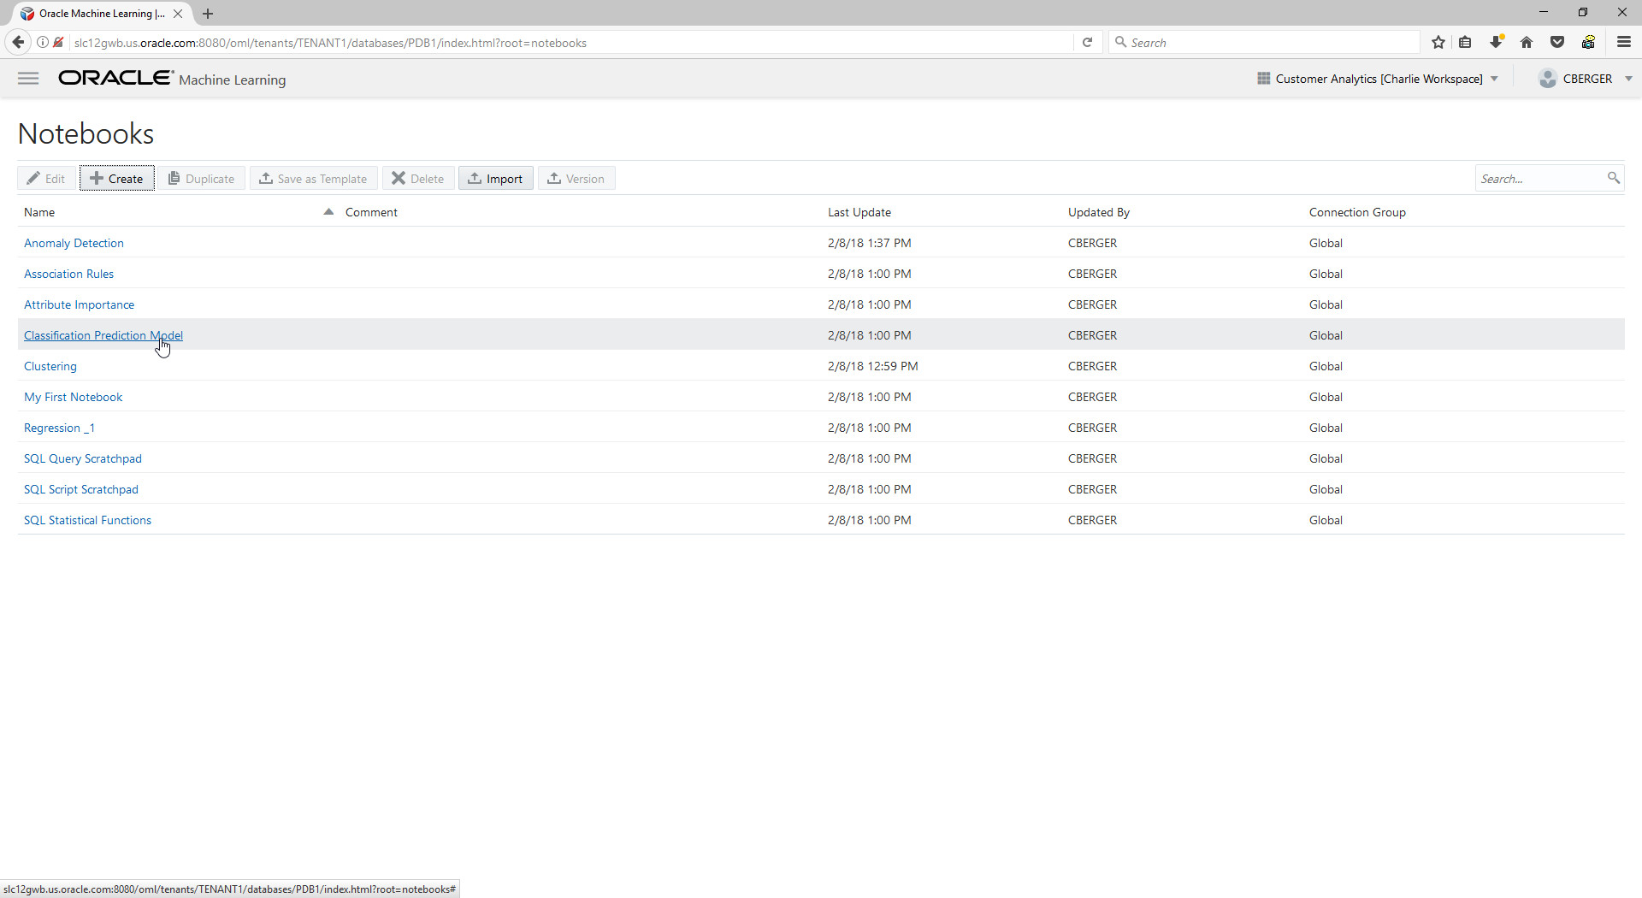

Slide 23
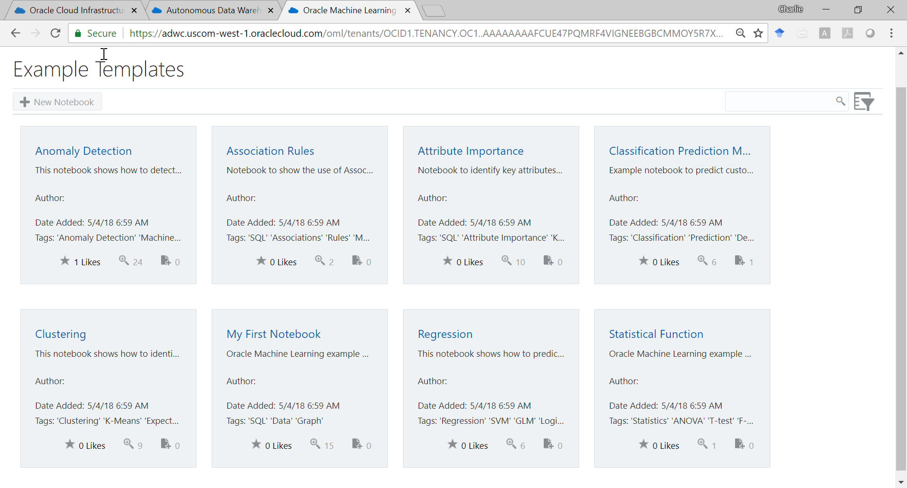

Slide 24
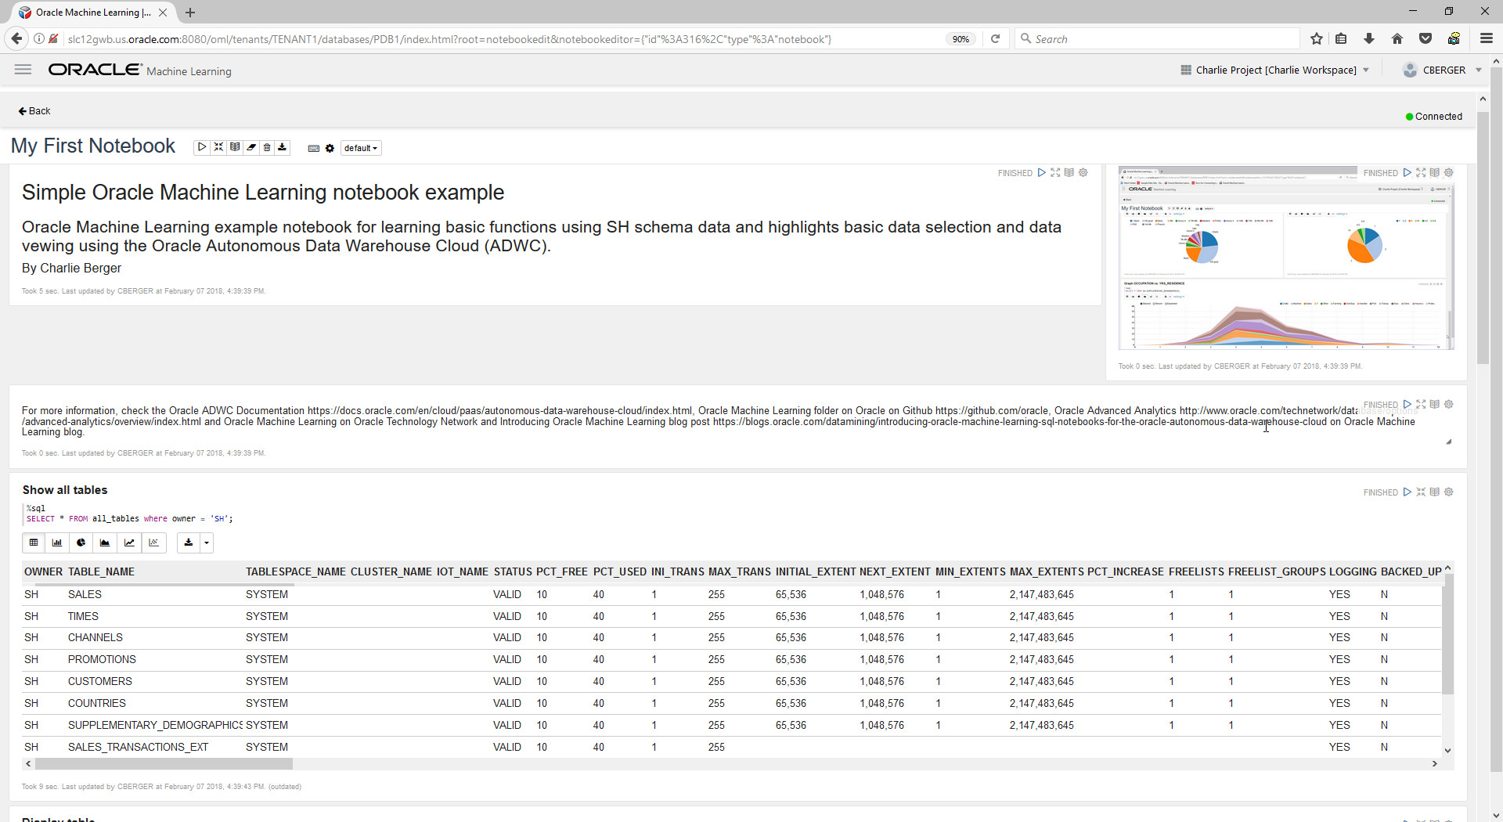

Slide 26
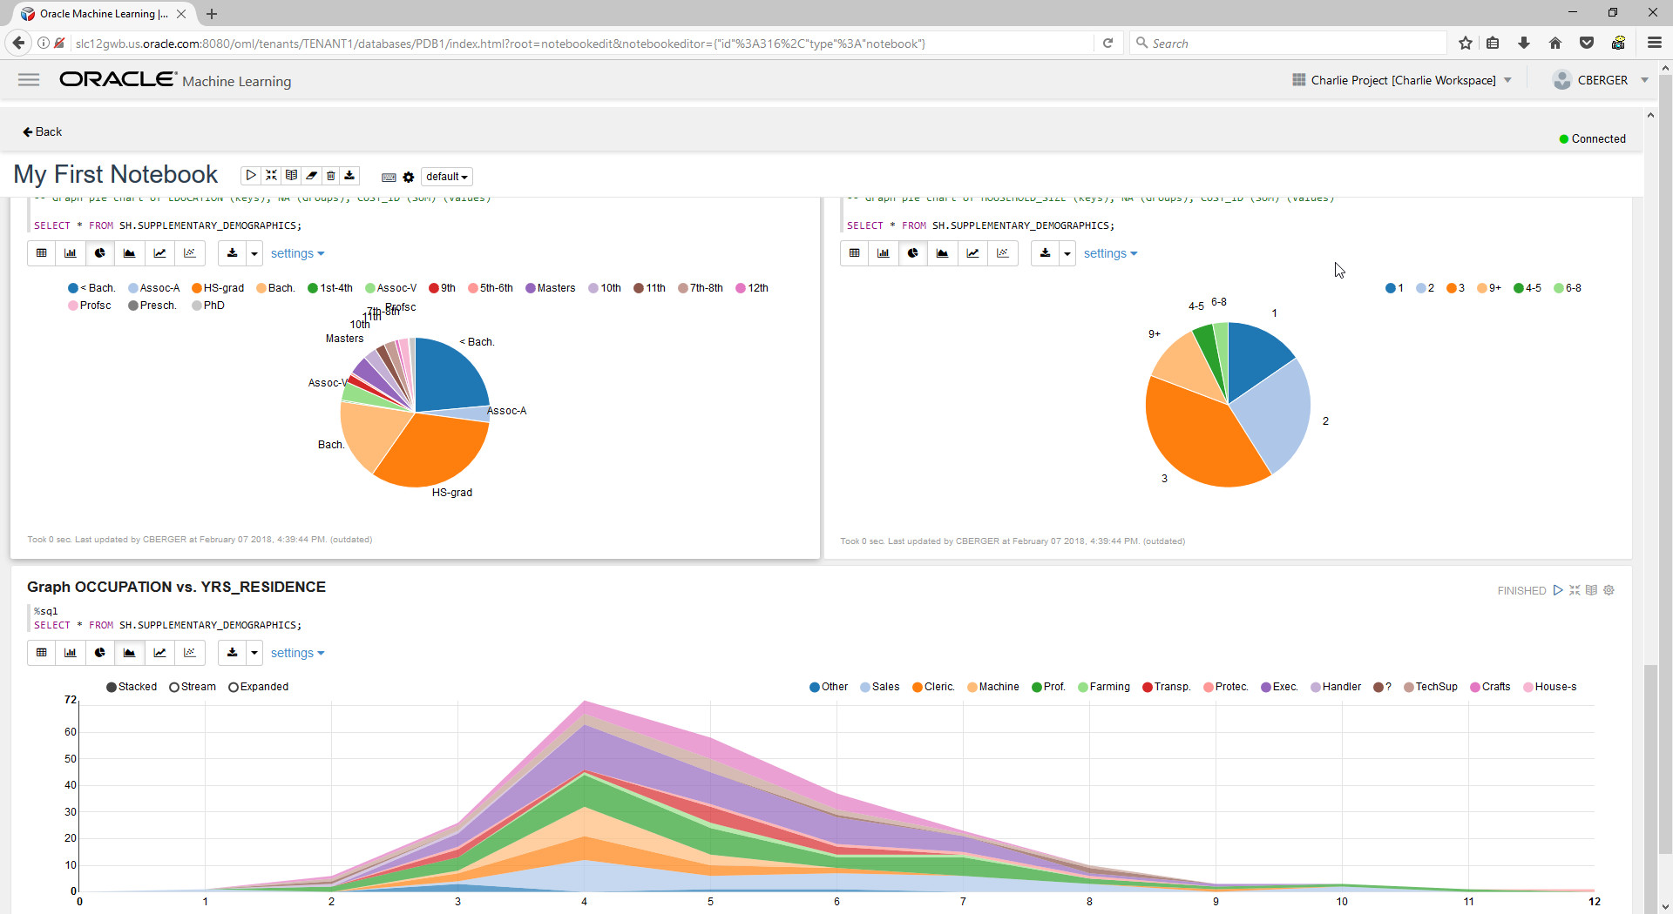

Slide 27
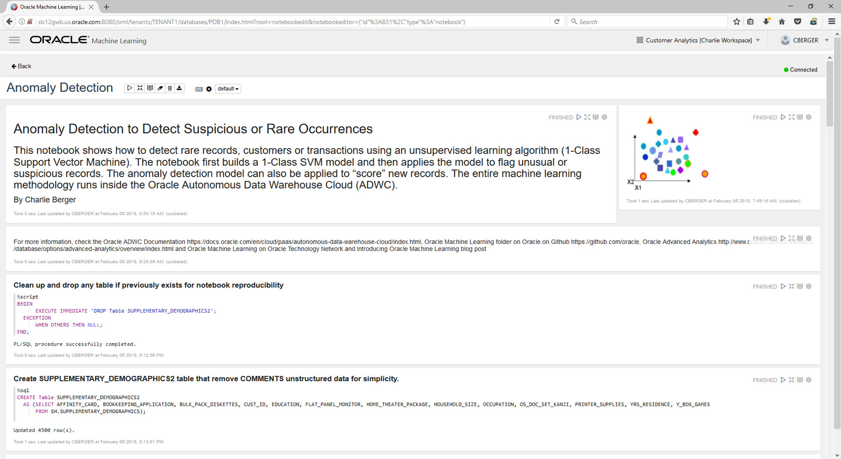

Slide 28
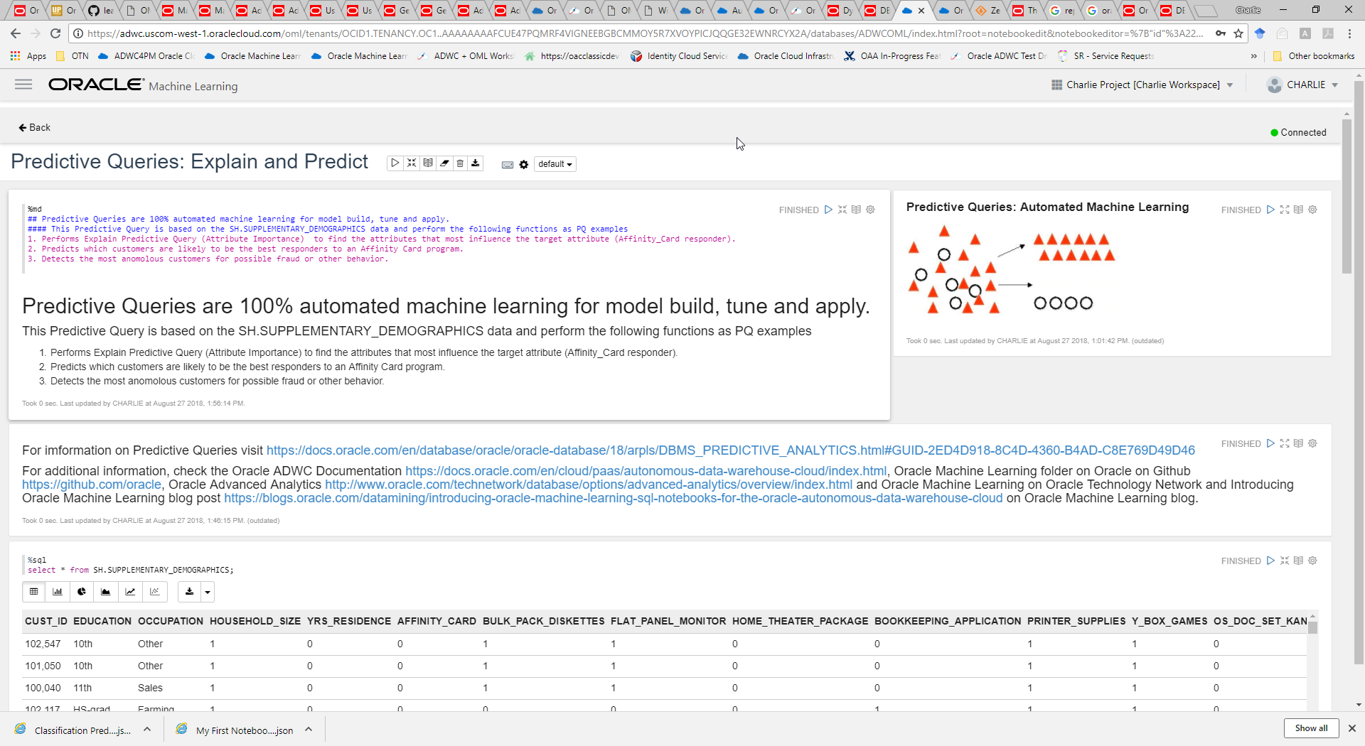

Slide 29
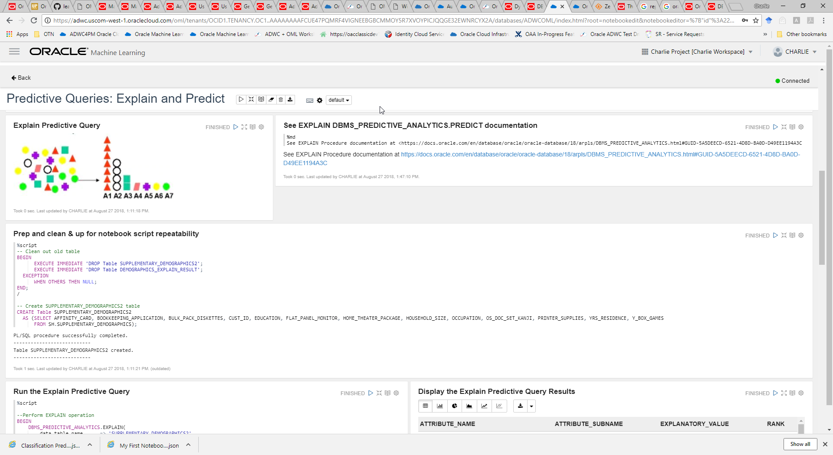

Slide 30
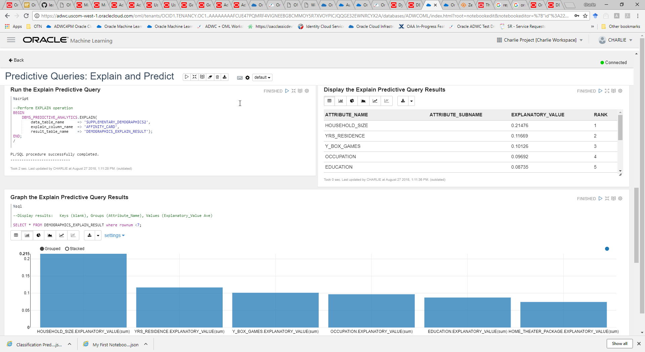

Slide 31
Quick OML + OAC Demo: Targeting Best Likely High Credit Score Customers

Slide 32
ML 101: ADWC + OML HOL Environment and Setup

Slide 33
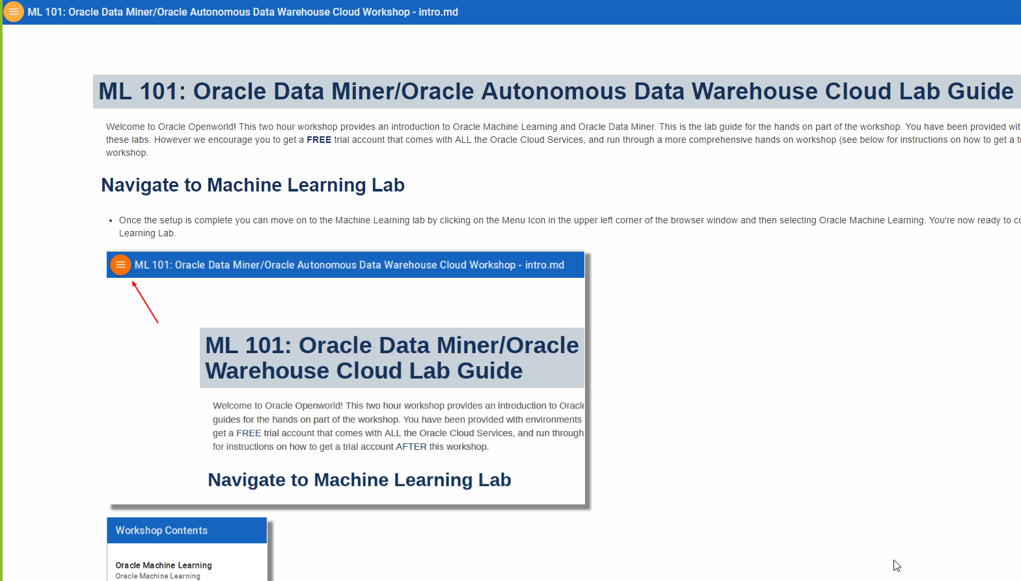
https://dgcameron.github.io/adwcml_oow/?page=intro.md

Slide 34
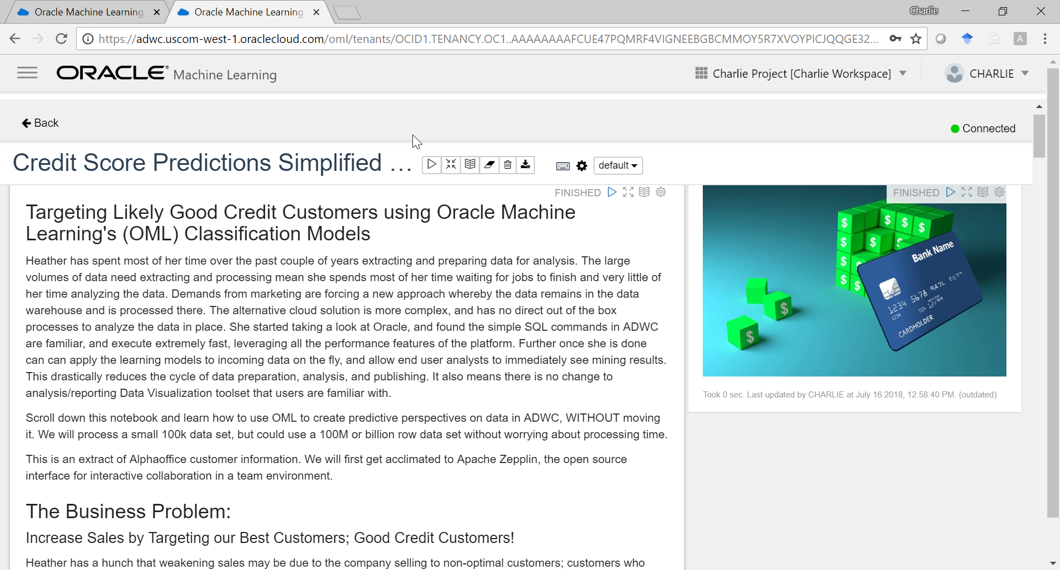

Slide 35
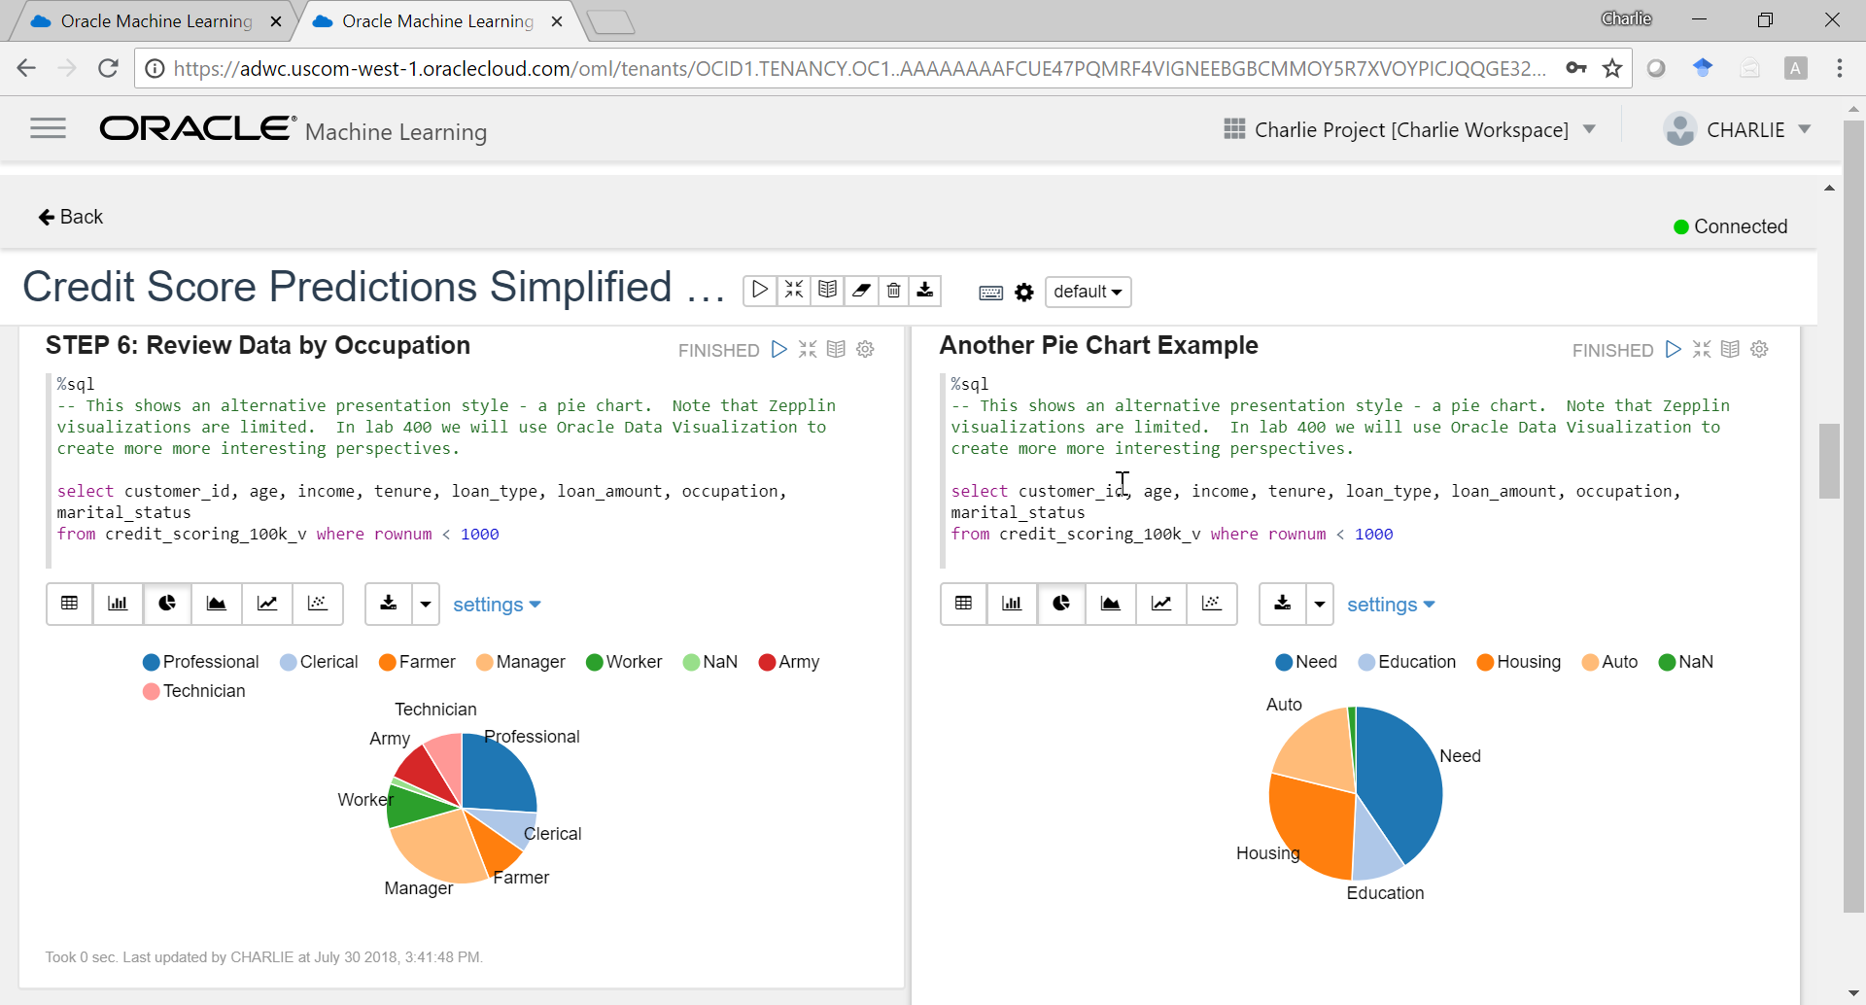

Slide 36


Slide 37


Slide 38


Slide 39


Slide 40


Slide 41


Slide 42
ML 101: Oracle Data Miner HOL Environment and Setup

Slide 43

Oracle Data Miner GUI
Oracle Cloud
Easy to Use for “Citizen Data Scientist”
Easy to use to define analytical methodologies that can be shared
SQL Developer Extension
Workflow API and generates SQL code for immediate deployment

Slide 44


Slide 45




Slide 46




Slide 47




ML 101: Oracle Data Miner
Follow the 5 Easy Steps to Login to Oracle Data Miner 18.2 and Oracle DB 18c Cloud
We’re using Oracle Secure Global Desktop (http://dma.oraclepts.nl/) to connect to DB 18c on a Cloud!
4
Click HTML5 Client
1
Click Login
2
But don’t login yet…
Login to Oracle Cloud
Username: user”N” e.g. user02 Password: OraclePTS2018#
5
3
Click Client Options

Slide 48


Slide 49

1
Click X Desktop to start
…and or Start/Play button to restart

Slide 50

1
Launch SQL Developer with Oracle Data Miner UI
2
Launch OBE Tutorials for Oracle Data Miner…

Slide 51


Slide 52


Slide 53

1
Launch the OBE Tutorials for Oracle Data Miner UI

Slide 54


Slide 55

1
Click View Data Miner UI

Slide 56

1
4
Components (Nodes)
Connections, Projects & Workflows
2
Workflow Editor
3
Properties

Slide 57

Oracle Data Miner 18.1 and Oracle DB 18c
Machine Learning 101 with Oracle Data Miner and ADWC's Machine Learning Notebook
P
Done
Step 1—Install SQLDEV 18.1
Step 2—Remote Desktop Connect to Ravello Instance of Oracle Database
Step 3—Start HOL!
dmuser/dmuser
Demo data for learning
Follow 3-5 OBE Online Tutorials
Using Oracle Data Miner 17.2
Star Schema Mining Using Oracle Data Miner 17.2
Text Mining with an EM Clustering Model Using Data Miner 17.2
Anomaly Detection (CLAIMS) See Instructor for assistance
Market Basket Analysis (SH.SALES) See Instructor for assistance

Slide 58


Oracle Data Miner 18.1 and Oracle DB 18c
We’re Using the Oracle by Example 17.4 Free Online Tutorials
Google “Oracle Data Miner”
Scroll down to bottom of page & launch tutorials
https://apexapps.oracle.com/pls/apex/f?p=44785:24::: NO::P24_CONTENT_ID,P24_PREV_PAGE:11925,2

Slide 59


OAA/Oracle Data Miner 17.4 HOL
Uses Oracle by Example Free Online Tutorials
There are 6 Tutorials
The first tutorial is already done for you
Recommend doing 3-5 Tutorials
Using Oracle Data Miner 17.2
Star Schema Mining Using Oracle Data Miner 4.1 (next slide)
Text Mining with an EM Clustering Model Using Data Miner 17.2
Anomaly Detection (CLAIMS) See Instructor for assistance
Market Basket Analysis (SH.SALES) See Instructor for assistance
P

Slide 60

Oracle Data Miner 18.2 and Oracle DB 18c
Uses Oracle by Example Free Online Tutorials
There are 6 Tutorials
The first tutorial is already done for you
Recommend doing 3-5 Tutorials
Using Oracle Data Miner 17.2
Star Schema Mining Using Oracle Data Miner 4.1
Text Mining with an EM Clustering Model Using Data Miner 17.2
Anomaly Detection (CLAIMS) See Instructor for assistance
Market Basket Analysis (SH.SALES) See Instructor for assistance

Slide 61

Great book on Oracle Advanced Analytics
Available on Amazon or from Author
Predictive Analytics Using Oracle Data Miner: Develop for ODM in SQL & PL/SQL

Slide 62



Oracle Data Miner 17.4 HOL
Setting Up Oracle Data Miner
P
Done

Slide 63



Oracle Data Miner 17.4 HOL
Setting Up Oracle Data Miner
P
Done

Slide 64

Cool New 17.4 Features
Workflow Scheduler

Slide 65

Previewing a 4.2 Feature
Workflow Scheduler

Slide 66

Previewing a 4.2 Feature
Workflow Scheduler

Slide 67

Previewing a 4.2 Feature
Workflow Scheduler

Slide 68

Previewing a 4.2 Feature
Workflow Scheduler

Slide 69

Previewing a Cool New 17.2 Feature
Workflow Scheduler—Email Notifications

Slide 71

Oracle Data Miner “Workflow” UI
Oracle Cloud
Easy to use for “Citizen Data Scientist”; Fast to Deploy via SQL and PL/SQL Scripts
SQL Developer Extension
Easy to use to define analytical methodologies that can be shared
Workflow API and generates SQL code for deployment
Step 1. “Citizen Data Scientist” builds, tests, applies ML methodologies using DS IDEs (ODMr, RStudio)
Step 2. → Insights & Predictions in Database for OAC/DV user additional Viz/Analytics

Slide 75

OAA Oracle Data Mining SQL Sample Programs
Starter SQL and PL/SQL Scripts for Learning and Fast-Starts
Oracle Database PL/SQL Packages and Types Reference for syntax of the PL/SQL API
Oracle Data Mining Application Developer's Guide is a Virtual Book with links for information on the use of the APIs
Oracle Database SQL Language Reference for syntax of the SQL functions for model scoring
Notes:
If you are more comfortable going directly to the SQL APIs, then the same anomaly detection methodology can be written and applied as a SQL script.
Oracle Data Miner GUI also generates the SQL scripts for each analytical methodology “workflow” to you can easily use ODM’r to quickly create, evaluate, iterate and refine a methodology and then “right mouse click” to generate the associated SQL to accelerate model deployment.
I like to show this SQL data mining example for anomaly detection to show the simplicity and power of OAA. The dbms_data_mining.create_model function, in this example, build a model called “CLAIMSMODEL”, performs a Classification type model (using a SVM model with no target field) using the “CLAIMS” table or view.
Once, built, the CLAIMSMODEL can be called within any SQL select statement or query Whereas, the model build process may take a few seconds, minutes or in extreme cases, hours, once built an OAA dm model runs as a SQL function and so can support real-time apply in e.g. Call Centers or other Online Transaction Processing environments.

Slide 76
OAA Oracle Data Mining SQL Sample Programs
Directory Listing of the Data Mining Sample Programs
dmaidemo.sql
dmkmdemo.sql
dmsvddemo.sql
dmardemo.sql
dmnbdemo.sql
dmsvodem.sql
dmdtdemo.sql
dmnmdemo.sql
dmsvrdem.sql
dmdtxvlddemo.sql
dmocdemo.sql
dmtxtnmf.sql
dmemdemo.sql
dmsh.sql
dmtxtsvm.sql
dmglcdem.sql
dmshgrants.sql
dmglrdem.sql
dmstardemo.sql
dmhpdemo.sql
dmsvcdem.sql
Notes:
If you are more comfortable going directly to the SQL APIs, then the same anomaly detection methodology can be written and applied as a SQL script.
Oracle Data Miner GUI also generates the SQL scripts for each analytical methodology “workflow” to you can easily use ODM’r to quickly create, evaluate, iterate and refine a methodology and then “right mouse click” to generate the associated SQL to accelerate model deployment.
I like to show this SQL data mining example for anomaly detection to show the simplicity and power of OAA. The dbms_data_mining.create_model function, in this example, build a model called “CLAIMSMODEL”, performs a Classification type model (using a SVM model with no target field) using the “CLAIMS” table or view.
Once, built, the CLAIMSMODEL can be called within any SQL select statement or query Whereas, the model build process may take a few seconds, minutes or in extreme cases, hours, once built an OAA dm model runs as a SQL function and so can support real-time apply in e.g. Call Centers or other Online Transaction Processing environments.

Slide 77

OAA Oracle Data Mining SQL Sample Programs
dmaidemo.sql—Predictive analytics EXPLAIN routine
-- Cleanup old output table for repeat runs
BEGIN EXECUTE IMMEDIATE 'DROP TABLE ai_explain_output';
EXCEPTION WHEN OTHERS THEN NULL; END;
/
-------------------
-- Run the EXPLAIN routine to get attribute importance results
BEGIN
DBMS_PREDICTIVE_ANALYTICS.EXPLAIN(
data_table_name => 'mining_data_build_v',
explain_column_name => 'affinity_card',
result_table_name => 'ai_explain_output');
END;
/
------------------------
-- DISPLAY RESULTS
--
-- List of attribute names ranked by their importance value.
-- The larger the value, the more impact that attribute has
-- on causing variation in the target column.
--
column attribute_name format a40
column explanatory_value format 9.999
SELECT attribute_name, explanatory_value, rank
FROM ai_explain_output
ORDER BY rank, attribute_name;
A1 A2 A3 A4 A5 A6 A7
Notes:
If you are more comfortable going directly to the SQL APIs, then the same anomaly detection methodology can be written and applied as a SQL script.
Oracle Data Miner GUI also generates the SQL scripts for each analytical methodology “workflow” to you can easily use ODM’r to quickly create, evaluate, iterate and refine a methodology and then “right mouse click” to generate the associated SQL to accelerate model deployment.
I like to show this SQL data mining example for anomaly detection to show the simplicity and power of OAA. The dbms_data_mining.create_model function, in this example, build a model called “CLAIMSMODEL”, performs a Classification type model (using a SVM model with no target field) using the “CLAIMS” table or view.
Once, built, the CLAIMSMODEL can be called within any SQL select statement or query Whereas, the model build process may take a few seconds, minutes or in extreme cases, hours, once built an OAA dm model runs as a SQL function and so can support real-time apply in e.g. Call Centers or other Online Transaction Processing environments.

Slide 78

OAA Oracle Data Mining SQL Sample Programs
dmdtdemo.sql –DBMS_DATA_MINING package – Decision Tree
-- Given demographic data about a set of customers, predict the
-- customer response to an affinity card program using a classifier
-- based on Decision Trees algorithm.
-- CREATE A NEW MODEL
--
-- Build a DT model
BEGIN
DBMS_DATA_MINING.CREATE_MODEL(
model_name => 'DT_SH_Clas_sample',
mining_function => dbms_data_mining.classification,
data_table_name => 'mining_data_build_v',
case_id_column_name => 'cust_id',
target_column_name => 'affinity_card',
settings_table_name => 'dt_sh_sample_settings');
END;
/
SELECT T.cust_id, S.prediction, S.probability, S.cost
FROM (SELECT cust_id,
PREDICTION_SET(dt_sh_clas_sample COST MODEL USING *) pset
FROM mining_data_apply_v
WHERE cust_id < 100011) T,
TABLE(T.pset) S
ORDER BY cust_id, S.prediction;
Notes:
If you are more comfortable going directly to the SQL APIs, then the same anomaly detection methodology can be written and applied as a SQL script.
Oracle Data Miner GUI also generates the SQL scripts for each analytical methodology “workflow” to you can easily use ODM’r to quickly create, evaluate, iterate and refine a methodology and then “right mouse click” to generate the associated SQL to accelerate model deployment.
I like to show this SQL data mining example for anomaly detection to show the simplicity and power of OAA. The dbms_data_mining.create_model function, in this example, build a model called “CLAIMSMODEL”, performs a Classification type model (using a SVM model with no target field) using the “CLAIMS” table or view.
Once, built, the CLAIMSMODEL can be called within any SQL select statement or query Whereas, the model build process may take a few seconds, minutes or in extreme cases, hours, once built an OAA dm model runs as a SQL function and so can support real-time apply in e.g. Call Centers or other Online Transaction Processing environments.

Slide 79








Getting Started—Oracle ML/AA Resources & Links
Oracle Advanced Analytics Overview Information
Oracle's Machine Learning and Advanced Analytics 12.2c and Oracle Data Miner 4.2 New Features preso
Oracle Advanced Analytics Public Customer References
Oracle’s Machine Learning and Advanced Analytics Data Management Platforms white paper on OTN
Oracle INTERNAL ONLY OAA Product Management Wiki and Beehive Workspace (contains latest presentations, demos, product, etc. information)
YouTube recorded Oracle Advanced Analytics Presentations and Demos, White Papers
Oracle's Machine Learning & Advanced Analytics 12.2 & Oracle Data Miner 4.2 New Features YouTube video
Library of YouTube Movies on Oracle Advanced Analytics, Data Mining, Machine Learning (7+ “live” Demos e.g. Oracle Data Miner 4.0 New Features, Retail, Fraud, Loyalty, Overview, etc.)
Overview YouTube video of Oracle’s Advanced Analytics and Machine Learning
Getting Started/Training/Tutorials
Link to OAA/Oracle Data Miner Workflow GUI Online (free) Tutorial Series on OTN
Link to OAA/Oracle R Enterprise (free) Tutorial Series on OTN
Link to Try the Oracle Cloud Now!
Link to Getting Started w/ ODM blog entry
Link to New OAA/Oracle Data Mining 2-Day Instructor Led Oracle University course.
Oracle Data Mining Sample Code Examples
Additional Resources, Documentation & OTN Discussion Forums
Oracle Advanced Analytics Option on OTN page
OAA/Oracle Data Mining on OTN page, ODM Documentation & ODM Blog
OAA/Oracle R Enterprise page on OTN page, ORE Documentation & ORE Blog
Oracle SQL based Basic Statistical functions on OTN
Oracle R Advanced Analytics for Hadoop (ORAAH) on OTN
Analytics and Data Summit , All Analytics, All Data, No Nonsense. March 12-14, 2019, Redwood Shores, CA

Slide 80
More Information on Oracle Machine Learning @ OOW’18
Oracle Open World & Code One
Oracle Campground Demo Pod #1623
Oracle’s Machine Learning for the Cloud, Databases and Big Data using SQL, R and Notebooks
Meet the Experts, Lounge B, Tuesday 4-5 pm
Oracle’s Machine Learning and Advanced Analytics, Charlie Berger, Marcos Arancibia
Notes:
If you are more comfortable going directly to the SQL APIs, then the same anomaly detection methodology can be written and applied as a SQL script.
Oracle Data Miner GUI also generates the SQL scripts for each analytical methodology “workflow” to you can easily use ODM’r to quickly create, evaluate, iterate and refine a methodology and then “right mouse click” to generate the associated SQL to accelerate model deployment.
I like to show this SQL data mining example for anomaly detection to show the simplicity and power of OAA. The dbms_data_mining.create_model function, in this example, build a model called “CLAIMSMODEL”, performs a Classification type model (using a SVM model with no target field) using the “CLAIMS” table or view.
Once, built, the CLAIMSMODEL can be called within any SQL select statement or query Whereas, the model build process may take a few seconds, minutes or in extreme cases, hours, once built an OAA dm model runs as a SQL function and so can support real-time apply in e.g. Call Centers or other Online Transaction Processing environments.

Slide 81



Analytics and Data Summit
All Analytics. All Data. No Nonsense.
March 12 – 14, 2019
Formerly called the BIWA Summit with the Spatial and Graph Summit
Same great technical content…new name!
www.AnalyticsandDataSummit.org
Notes:
We’d like to mention an upcoming conference that may be of interest. The Analytics and Data Summit (formerly BIWA) will be held with the Oracle Spatial & Graph Summit, in March 2018 at Oracle’s headquarters in Redwood Shores, will include technical content spanning Big Data, Analytics, Spatial & Graph, Cloud, and IoT technologies.
This is the premier event for Spatial + Graph, featuring thought leaders, and experts from Oracle as well as our partner and customer community worldwide. The agenda includes technical sessions, and hands on labs for you to get deep dives and work with the technologies, and customer use cases.
The call for speakers is now open, and presentations are being selected. We encourage you to submit your use case studies highlighting Oracle’s spatial, graph, analytics, cloud, big data technologies for consideration.
We invite you to consider joining us for this event.
Call for speakers and registration are now open at www.analyticsanddatasummit.org .
A more detailed list of sessions + speakers is available at the event website.

Slide 82


Try ADWC + OML for FREE!
FREEE Oracle Cloud Credits - https://go.oracle.com/adwc
1
2
Notes:
If you are more comfortable going directly to the SQL APIs, then the same anomaly detection methodology can be written and applied as a SQL script.
Oracle Data Miner GUI also generates the SQL scripts for each analytical methodology “workflow” to you can easily use ODM’r to quickly create, evaluate, iterate and refine a methodology and then “right mouse click” to generate the associated SQL to accelerate model deployment.
I like to show this SQL data mining example for anomaly detection to show the simplicity and power of OAA. The dbms_data_mining.create_model function, in this example, build a model called “CLAIMSMODEL”, performs a Classification type model (using a SVM model with no target field) using the “CLAIMS” table or view.
Once, built, the CLAIMSMODEL can be called within any SQL select statement or query Whereas, the model build process may take a few seconds, minutes or in extreme cases, hours, once built an OAA dm model runs as a SQL function and so can support real-time apply in e.g. Call Centers or other Online Transaction Processing environments.

